Slide 1
Addressing Concerns Around Bees: an Industry Approach
The Pesticide Stewardship Alliance
Mobile , Alabama
February 6th, 1013
Iain Kelly. Ph.D. Bayer CropScience
Slide 0

Slide 2

Bees and agriculture
Background to pesticide registration
Neonicotinoid seed treatments and bees
Ongoing activities to understand and minimize exposure
Bee health activities
Summary
Outline
Page 1

Slide 3
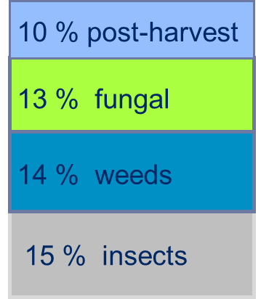
Need for Crop Protection Products and Pollinators
  Average global yield losses without crop protection (rice, wheat, barley, corn, potatoes, soybeans, cotton, coffee*)
Economic contribution of pollinators to global food crop production
10% pollinators
Sustainable agriculture requires efficient pollination services and responsible use of pesticides
Page 2
* approx. 50 % of crop area worldwide - Source: Oerke et al., 1995 / Yudelman et al., 1998
* *Gallai et al. 2009

Slide 4
Crop Protection , Apiculture and Agriculture Intersect
Beekeeping*: The art, science, and business of managing honey bees for the production of hive products and bee stock, and for pollination services.
    Farming*: The science, art, and business of cultivating soil, producing crops, and raising livestock.
Pollinators are essential to agriculture and vice versa
    Crop Protection Industry: Development of products to protect crops, livestock and bees. The supply, production and improvement of seeds often requiring pollination services.
3
*Adapted from www.thefreedictionary.com

Slide 5
Lifecycle Assessment of Pesticide Safety
200,000+
50-80
18
6
3-4
2-3
Compounds
Microplot (greenhouse)
Miniplot (field)
Pre - project
decision
Registration
Reregistration
Broad field
Project
decision
Submission
Decisions
Surrogate exposure
High end
exposure
Actual exposure
In vitro, acute
NOEL estimates, developmental
Advancing science
Definitive regulatory studies
Safety Testing
Repeated doses, dose/effect, MoA, target organ
New information
Eco-prelim
New uses
Aquatic
Slide 4
Beneficials

Slide 6
Safety Standard for Pesticides
Pesticides only registered after meeting an exacting safety standard
    No unreasonable adverse effects on the environment
    Reasonable certainty of no harm to humans
Regulatory determination made only after
    A more extensive and diverse testing scheme than for any class of chemistry
    Risk based evaluation of hazard (toxicity) and exposure
    Introduction of appropriate mitigation statements on the product label
  Post-registration , information increases and development continues
    More realistic exposure data is developed
    Real world experience incl. incident data is acquired (approved and misuse)
    Additional scientific investigations are conducted
    Technological improvements occur– equipment, formulation etc.
  Registration review
Slide 5

Slide 7
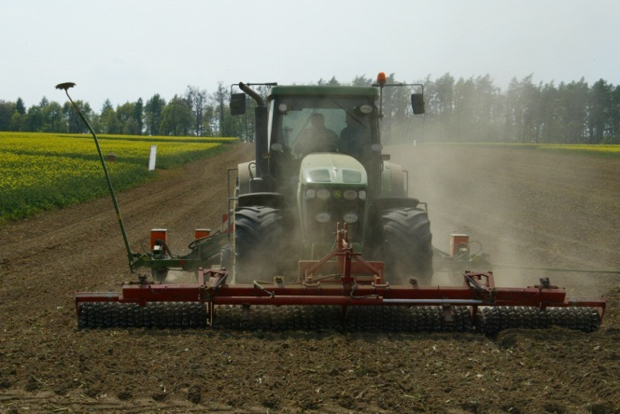
Addressing concerns around bees
Neonicotinoid Seed Treatments – a case study
  In April 2008 11,500 bee colonies suffered losses in Upper Rhine Valley in Germany at the time of planting neonicotinoid treated seed
  Investigations revealed that:
    For some seed batches, the application quality and use of film coatings was substandard leading to higher dust levels
    Most of the pneumatic vacuum planters used in the Upper Rhine Valley exhaust the emissions upward or to the side.
    Later than normal planting window
    Small field sizes (<10 acres) in close proximity to flowering crops (Oil Seed Rape)
    Dry weather and windy conditions led to dust drift
    Colonies recovered
    Conclusion
      Must ensure properly treated seeds and active stewardship
Slide 6
Slide 6

Slide 8

Neonicotinoid Seed Treatment - risks and benefits
Risks
  High toxicity to bees
  Need to minimize exposure
Benefits
  Application independent of weather conditions
  Fewer spray applications
  Positive effect on the health and vigor of the plant
  Reduced environmental impact due to lower application rates and less area treated
  Low mammalian toxicity
Slide 7

Slide 9

Reducing Risk = Reducing Exposure
  Toxicity DOES NOT equal risk
  Risk = Hazard (Toxicity) x Exposure
The toxicity of a pesticide remains constant regardless of its use
The exposure to a pesticide is dependent on the conditions surrounding its use
The risk associated with using a pesticide can only be reduced (mitigated) by decreasing the potential for exposure
8
Slide 8

Slide 10
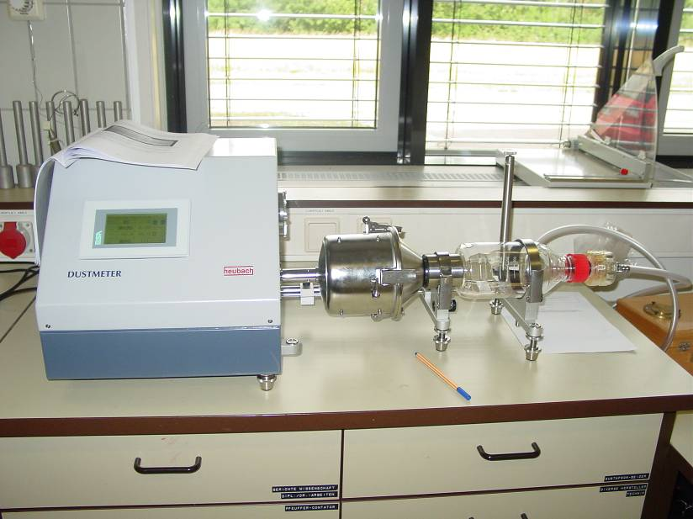
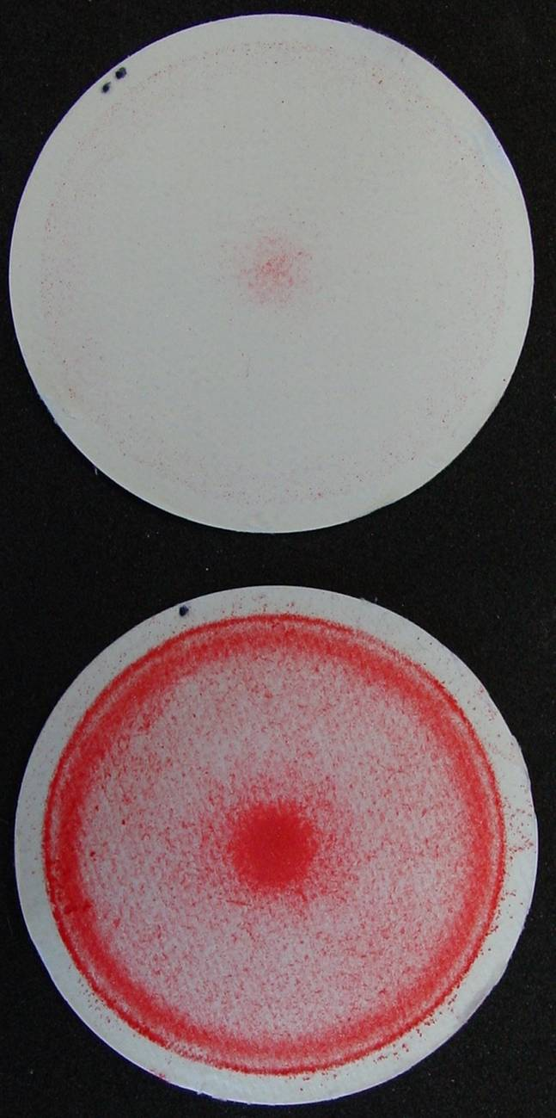
Established Equipment and Protocol for Standard Comparison of Dust-Abrasion
A
A: Good ST quality sample
B: Bad ST quality sample
B
Slide 9

Slide 11
Heubach Dust Testing – Commercially Treated Seed Samples – Seed Applied Insecticides
Lowest current proposed EU Standard is 0.75 gms per 100k seed
Slide 10

Slide 12
Alleged Bee Incidents involving Neonicotinoid Seed Treatment in the U.S.
2003 - 2010
2011
2012
2013
5 alleged cases listed in Reg. Rev.
NNC residues confirmed in one
One in IN (Krupke et al.)
Most from IN (7) & OH (6) Others sporadic
???
High Varroa levels, drought
2012 - possible cause of increase: awareness, publicity, weather, willingness to report? Combination of all of these indicated.
Trace residues found in dead bees in IN. No measurable residues in OH
BCS investigated one incident in IN (detect) and MN (no detect)
Slide 11

Slide 13
Recent Literature Studies (1)
Krupke et al. study
    Apparent small bee kill incidents investigated
    Field experiment conducted to measure exposure
        Exposure levels in soil, pollen, whole flowers do not explain how a bee kill happened
        Concentration in waste talc very high, but samples were only collected from inside a planter, no measurement of what was released into the environment
    No long-term colony-level impact noted
Slide 12

Slide 14
Recent Literature Studies (2)
Tapparo et al study and others from Girolami group
    Bees trained to fly through dust exhaust cloud during simulated planting
    Effects seen on individual bees, no colony level effects
    Minimal effects on individual bees from contact with contaminated flowers, or ingestion of guttation droplets; bees had to fly through the planter exhaust stream for effects to be prevalent
    Exposed bees placed in cages in laboratory
    Normal humidity – nearly all bees survived
    Very high humidity – most bees died
    No long-term colony-level impact
Slide 13

Slide 15
Practical Experiences with Neonicotinoid Treated Seeds in the U.S.
    Despite hundreds of millions of acres being planted with neonicotinoid treated seed there have been very few reported, acute bee losses
    There has been no demonstrated effect on bee colony health associated with use of clothianidin or other neonicotinoid-based insecticides
    Activities, however, to understand and minimize exposure and reduce the likelihood of effects are appropriate to help protect an important tool for growers
Slide 14

Slide 16
Ongoing Activities to Understand and Minimize Exposure
Understanding exposure routes
  Bee Health investigations
  Sentinel hives
  Mid-West Corn Seed Treatment Exposure Study
Improving the technology
  Optimizing product formulation, seed treatment recipes
  Monitoring treated seed samples for abrasion standards
  Developing alternative lubricants to talc to reduce dust
  Improved equipment to treat seed
  Planter modifications
Increased communication and stewardship
Slide 15

Slide 17
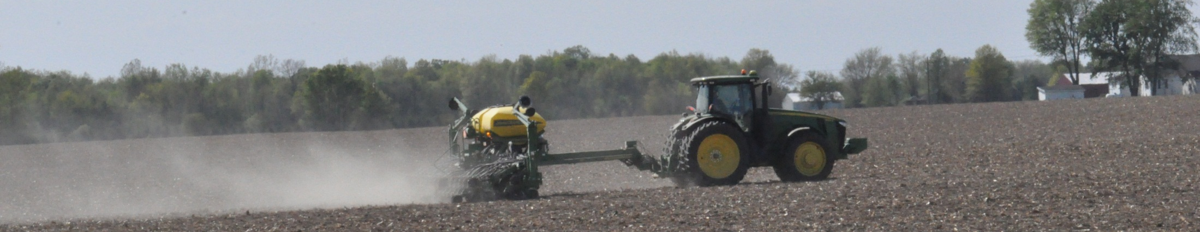
Bee Health Investigations in 2013:
Response Preparations
  Build on Bayer's experiences from 2012 in investigating alleged incidents around corn planting time
  Better understand potential product related issues, complementing any official investigations
  Contacting State Lead Agencies in Mid-west, seed partners, major bee organizations, pest control applicators, EPA , USDA for help and advice on implementation
  A dedicated toll-free number available for questions or concerns around bee health has been established
Slide 16

Slide 18
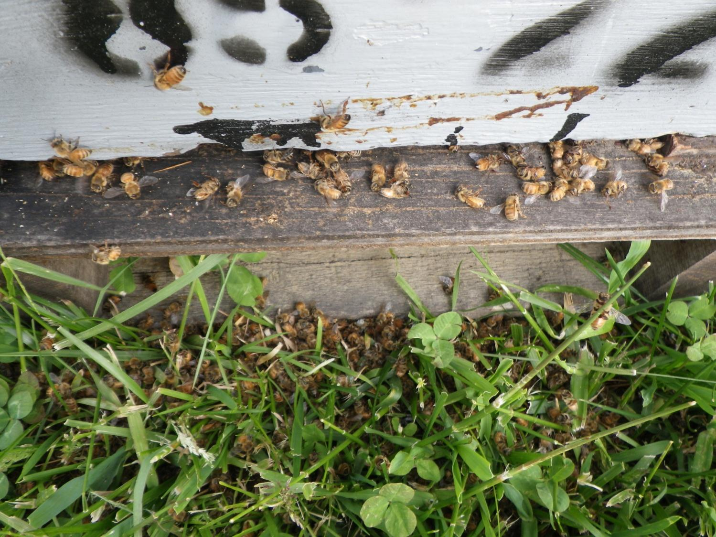
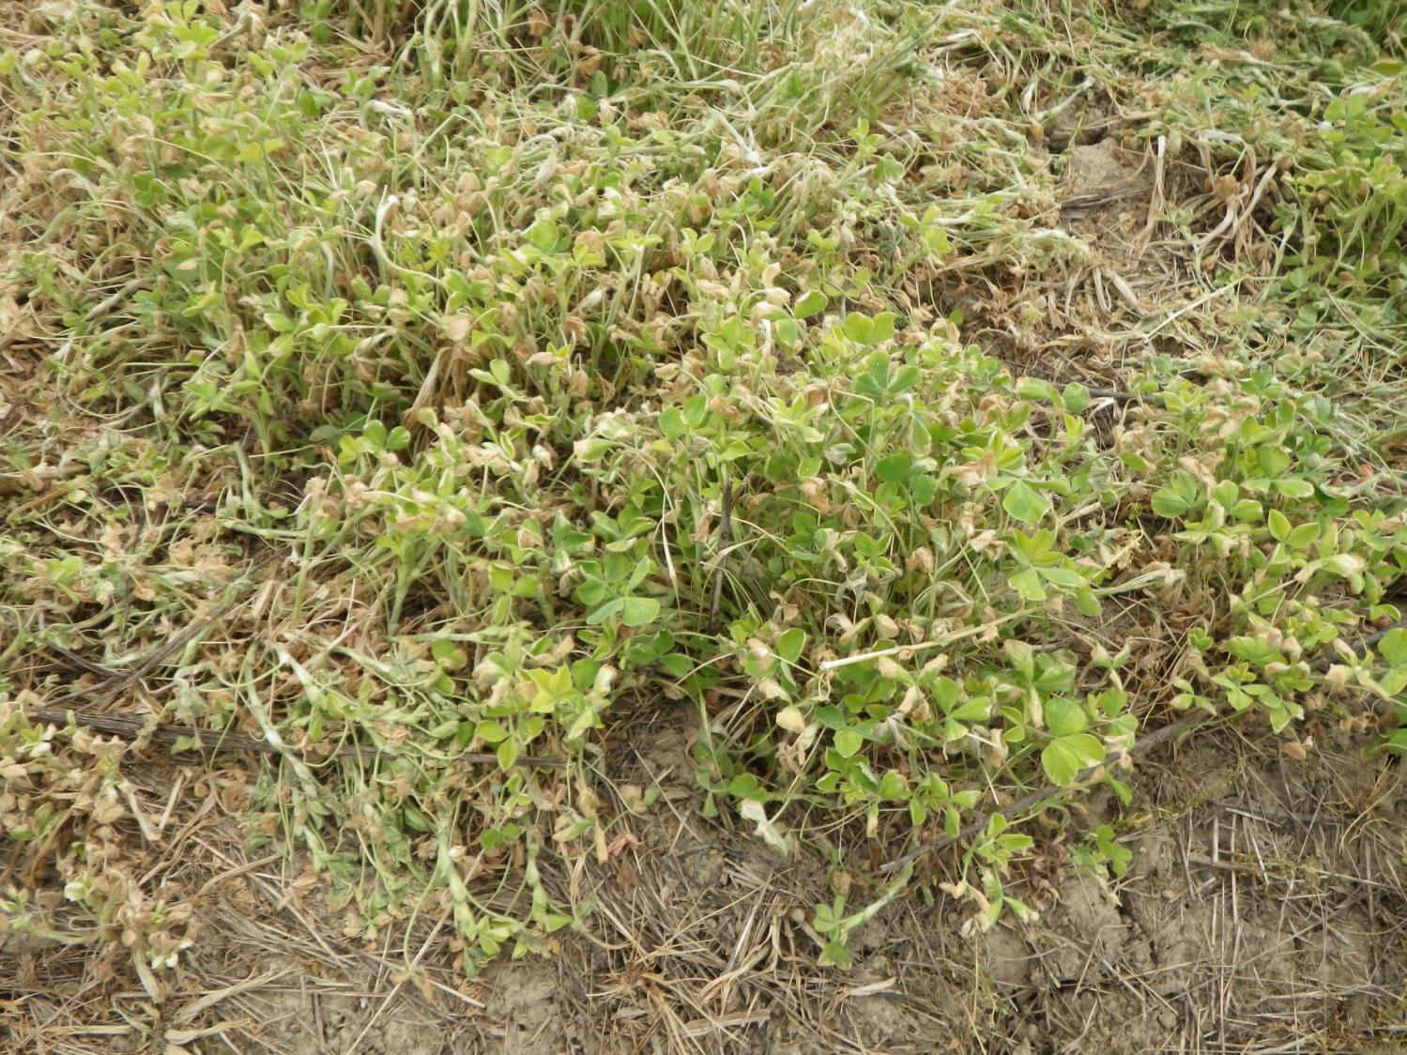
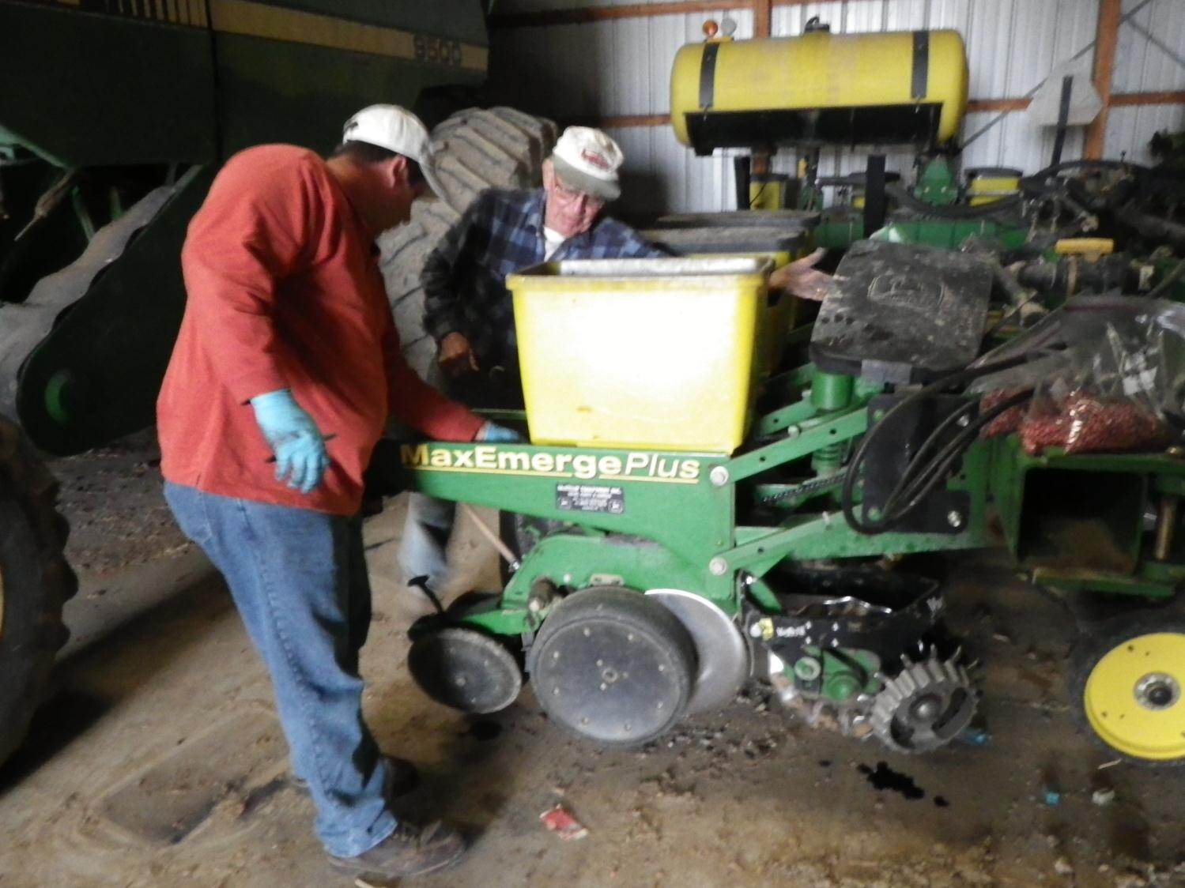
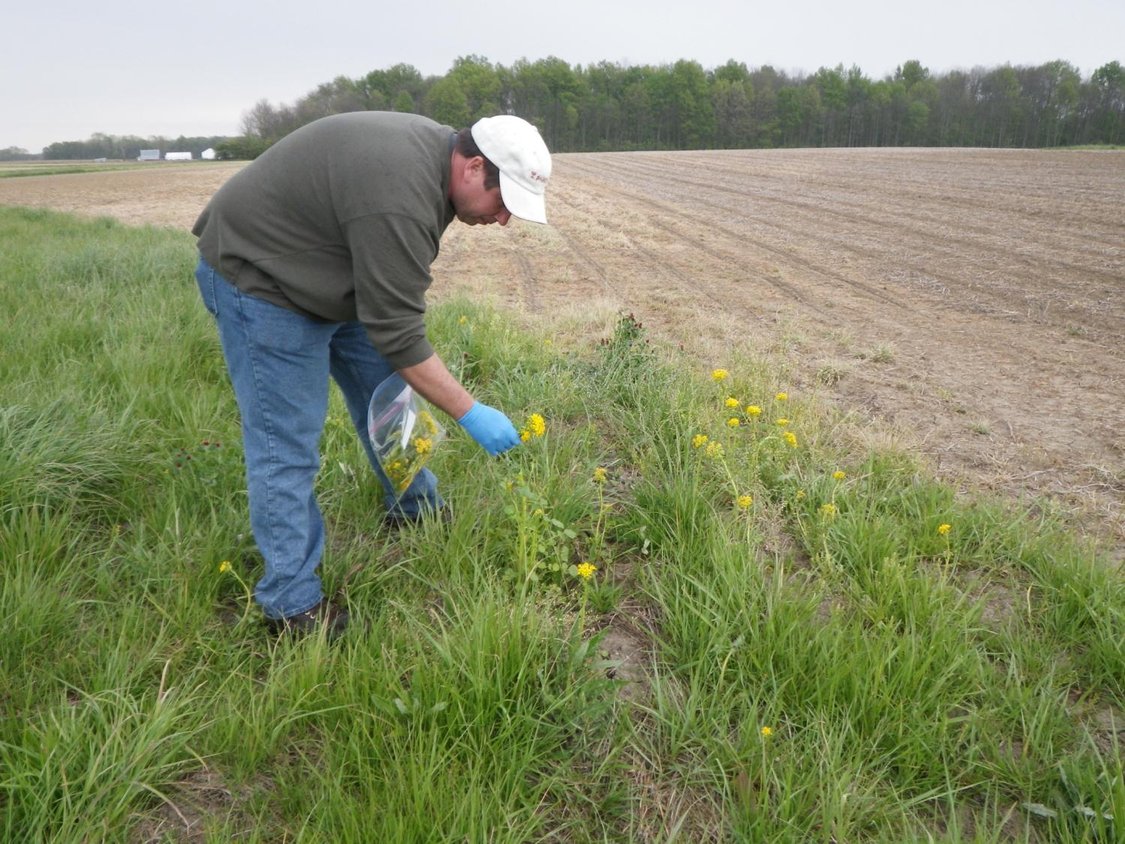
Bee Health Investigations in 2013:
Resources Available
  Investigation team consisting of over 30 trained individuals:
  Bee experts for hive inspections
  Technical field experts to survey agricultural surroundings
  Analytical experts to collect residue and bee samples for analysis
  Standardized protocols and SOP’s for conducting investigations
  iPad application to aid data collection (beta testing)
  Rapid response capability and fast analytical turn around time
  Intent is to supplement official investigations by focusing on sites that will help address mitigation/stewardship needs if warranted
Investigation of Hives
Investigation of Fields
Investigation of Planting
Investigation of Surroundings
Slide 17

Slide 19
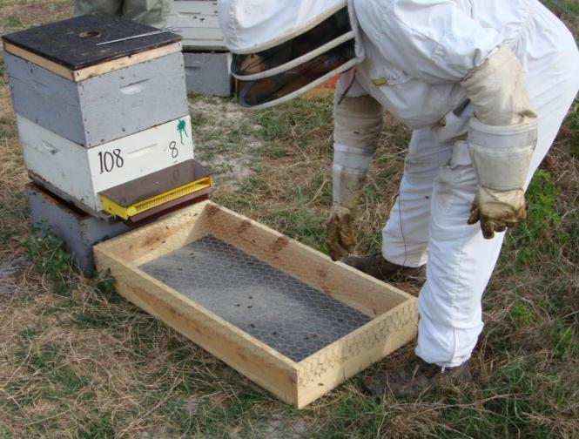
Dead Bee Drop Zone Traps

Slide 20
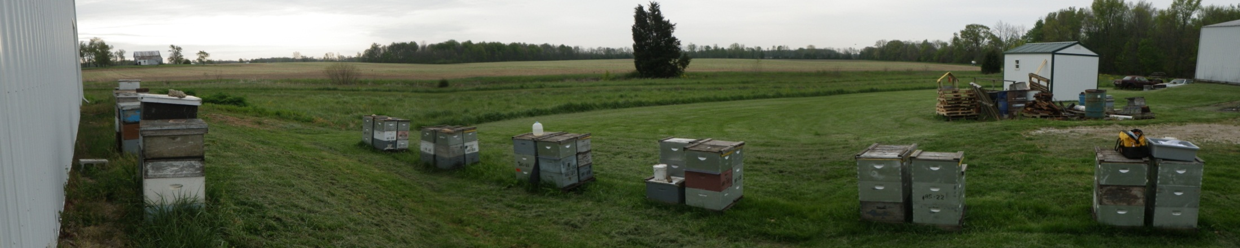
Sentinel Hives Program in Corn Growing Areas
Retrospective investigations have limitations
Will actively monitor and report on selected “healthy” honey bee colonies from participating beekeepers in 2013
Will monitor: intra-hive mortality with dead bee traps, varroa mite, tracheal mite, and Nosema loads etc.
Will record landscape data surrounding the colonies
Will analyze for neonicotinoids and other pesticide residues
Initiated the program in Indiana and pursuing proposal in Ontario
Slide 19

Slide 21
Mid-West Corn Seed Treatment Exposure Study
Bayer and Syngenta are partnering with other stakeholders to sponsor and oversee field research to identify best practices for reducing bee exposure
Funds given to Pollinator Partnership who prepared RFP
CDRC Steering Committee reviews bids, oversees study conduct
Study conducted by research team (multiple universities)
2013 work to focus on
  Seed lubricants (PE wax vs. Talc/Graphite)
  Vegetation management in/around fields prior to planting
Additional research likely in 2014
Develop further BMP recommendations for growers and beekeepers
Slide 20

Slide 22
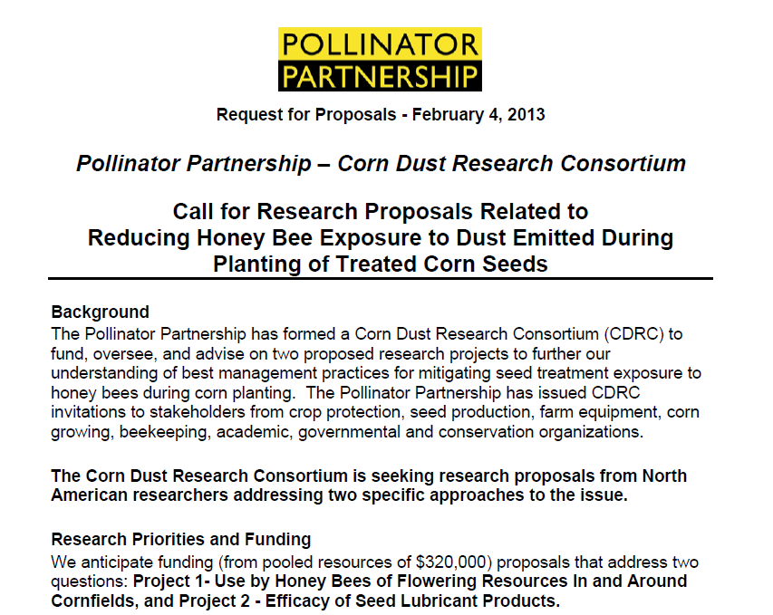
Slide 21

Slide 23
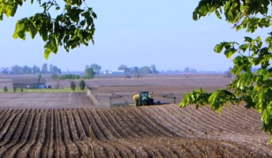
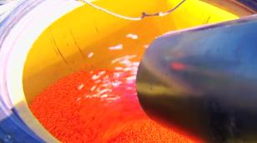
A Major Initiative: Reduce Dust by Replacing Talc as a Lubricant in Planters
  BCS developing an alternative planter lubricant to replace talc and reduce dust emissions from planters
  Significant decrease in both total dust (90%) and active ingredient dust emissions (65%) have been observed from the vacuum exhaust of planters in laboratory testing
  Testing in Southern Hemisphere now
  Large scale tests in U.S. with multiple manufacturers in 2013
  Goal to launch in 2014
Slide 22

Slide 24
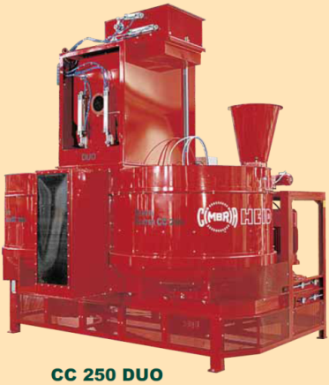

Application advancements
New technology has brought +/- 2% accuracy to high volume facilities
Seed testing for treatment quality characteristics.
Improvement of quality is a combination of equipment, process controls and materials applied to the seed.
Seed treaters are upgrading equipment training and stewardship initiatives.
Seed coatings are becoming a standard with heavier loadings
Seed treaters are more frequently engaging seed coating and applications experts to improve their product quality
Pelleting Equipment
High Volume Batch Treater
High precision Downstream Technology
Slide 23

Slide 25
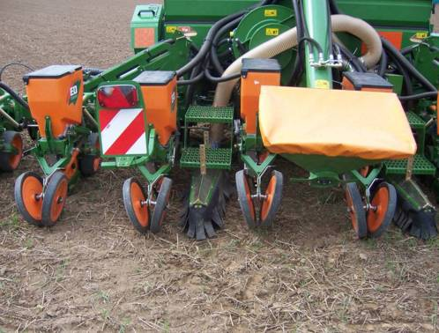
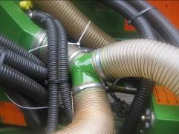
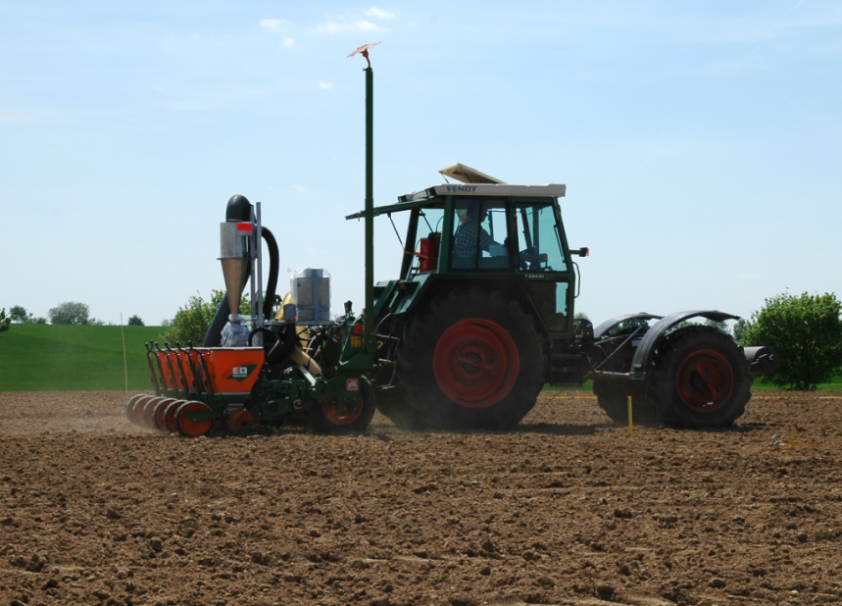
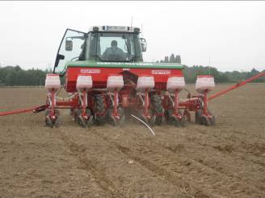
SeedGrowth Stewardship Activities
Equipment Modifications - Europe
Planters and agricultural practices very different in Europe. Mid-West Corn Seed Treatment Exposure Study will inform U.S. needs
Amazone Retrofit Kit
SweepAirTM Technology
Slide 24

Slide 26
Bayer SeedGrowth™ - A fully integrated system
Factors influencing seed treatment quality and stewardship
Initial Seed Quality and Conditioning
  Purity
  Screening, sorting and sizing
  Seed related dust properties
  Dust aspiration prior to treatment
  Mechanical, drying, or frost damage
SeedGrowth™ Equipment
  Calibration
  Type (batch/continuous flow)
  Monitoring of treatment process
  Dosing system (vol./weight)
  Operator safety
Quality of Bayer
SeedGrowth™
SeedGrowth™ Products
(formulation)
  Concentrated
  Easy to apply
  Stable
  Good adhesive properties
  Safe to seed
SeedGrowth™ Coatings
(slurry recipe)
  Liquid volume
  Film coatings
  Colorants
  Micronutrients
  Miscibility
Quality control
SeedGrowth™ Services
Dust abrasion
Loading analysis
Seed-to-seed distribution
Plantability
Service Center
Technical support
Testing
Training
Advice
Bayer provides optimized products
Bayer supports customized solutions
Slide 25

Slide 27
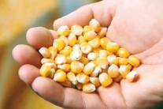
Quality Standard Initiative
Key components of the Quality Standard Initiative:
Apply to high-quality, clean seeds
Use only successfully tested and recommended application recipes
Use of recommended film coatings
Use of appropriate seed treatment application equipment
Monitor quality of representative samples of commercially
treated seed
Quality standards for workforce/training
Will help ensure:
Increased safety and efficiency of seed treatment products for the environment and the user dismissal
Bayer CropScience is responsible for providing high-quality products to seed
company partners who can help ensure high-quality seed treatments.
Slide 26

Slide 28
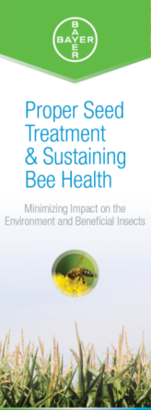
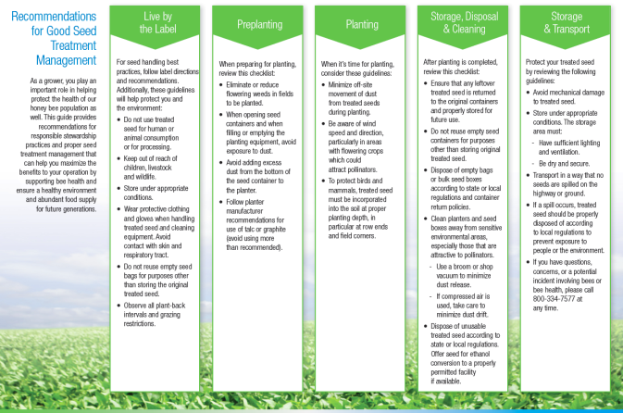
Stewardship brochures – distributed by meetings, conferences, training sessions, web posting, email to stakeholders and mailing to state officials
Slide 27

Slide 29
Successful stewardship involves multiple stakeholders
Registrants & seed companies:
    Collaborating on comprehensive stewardship programs to ensure proper treatment of seeds and management of treated seeds
    CLA/ASTA have developed a manual of seed treatment BMPs (release imminent)
Manufacturers of seed coating technology:
    research goal → less abraded dust.
Ag equipment manufacturers:
    Developing an international standard to guide design of planting equipment to control fugitive dust emissions.
Beekeepers - consider ways to reduce exposure
    Local communication with growers, register hives, restrict bee foraging at planting, move into areas after planting?
    Practices adapted to local conditions
28
Slide 28

Slide 30


Bee Health is not about Pesticides
  Multiple factors affecting bee health: pests, pathogens, diseases, lack of forage etc.
  Bayer Bee Care Center : Dedicated North American research facility into the factors affecting bee health (2013)
  Compliments our European BBCC
Will partner with multiple stakeholders involved in bee health
Consolidates over 25 years of bee health involvement
Ongoing activities
  Varroacide research
  Bee repellents
  Small hive beetle control
  Purification of beeswax (removal of pesticide residues)
  Pollinator habitat and nutrition
Bayer Bee Care Center
Slide 29

Slide 31
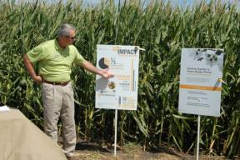

Bayer Communication Outreach
Local Engagement
  Bayer Bee Ambassador Program
  Over 100 employees across the country trained on key topics related to honey bee management and health
  Ambassadors engage at the local level with multiple stakeholders about the value of honey bees and the challenges they face
  Direct interaction with customers and growers reinforces the need for good stewardship and awareness of bees near fields
  Bee Tour
  Broad outreach activities planned include a mobile “bee unit” which will tour the mid west during the 6-8 weeks of planting season.
  This activity will focus on
    “Bayer’s Commitment to Bee Health” message
    Specific stewardship/research/good beekeeping practices
Slide 30

Slide 32
Summary
The safety assessment of pesticides is an ongoing process throughout the lifecycle of the compound and its associated products
Concerns have been raised around neonicotinoid seed treatments and effects on bees at corn planting
The concern has been raised following an unusual incident in Germany in 2008 predominantly due to poorly treated seed.
Very few reported incidents around corn planting in the U.S.
The potential for incidents can be reduced via multiple routes: improved formulations, better lubricants, equipment developments, increased stewardship etc.
The crop protection industry, seed coating manufactures, ag. equipment manufacturers are all proactively introducing these solutions
Declining bee health is a different issue from acute exposure.
Multiple stakeholders have a role if we are to improve bee health
31
Slide 31

Slide 33
Thank You For Your Attention
Slide 32

